Slide 2
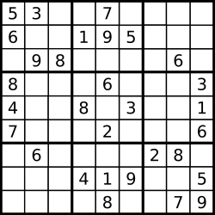
CheckRaw=[ 0 1 2 3 4 5 6 7 8 9 ]
[ 0 0 0 0 0 0 0 0 0 ]
CheckCol= [ 0 1 2 3 4 5 6 7 8 9 ]
[ 0 0 0 0 0 0 0 0 0 ]
CheckArray1=[ 0 1 2 3 4 5 6 7 8 9 ]
[ 0 0 0 0 0 0 0 0 0 ]
CheckArray2=[ 0 1 2 3 4 5 6 7 8 9 ]
[ 0 0 0 0 0 0 0 0 0 ]
CheckArray3=[ 0 1 2 3 4 5 6 7 8 9 ]
[ 0 0 0 0 0 0 0 0 0 ]
i
j

